Slide 1
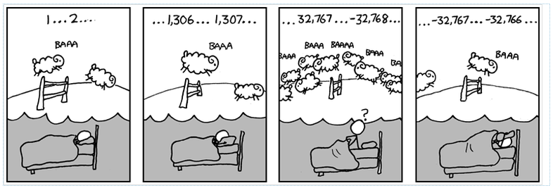

Slide 2
Inheritance
Zybooks Chapter 10

Slide 3
Inheritance
Sometimes one class is similar to another class but has some additions or variations
No reason to reinvent the wheel
Inheritance – Deriving qualities and characteristic from base classes
Derived Class
Base Class

Slide 4
Inheritance – Example
Generic Item Class
class GenericItem{
private:
string itemName;
int itemQuantity;
public:
void SetName(string);
void SetQuantity(int);
void PrintItem();
};
Produce Item Class
class ProduceItem: public GenericItem{
private:
string expirationDate;
public:
void SetExpiration(string);
};

Slide 5
Inheritance – Example
Generic Item Class
class GenericItem{
private:
string itemName;
int itemQuantity;
public:
void SetName(string);
void SetQuantity(int);
void PrintItem();
};
Produce Item Class
class ProduceItem : public GenericItem{
private:
string expirationDate;
public:
void SetExpiration(string);
};
: public GenericItem{ denotes that you want to inherit the GenericItem class
public denotes where you want to put the public member of GenericItem within ProduceItem

Slide 6
Inheritance – Example
Generic Item Class
class GenericItem{
private:
string itemName;
int itemQuantity;
public:
void SetName(string);
void SetQuantity(int);
void PrintItem();
};
Produce Item Class
class ProduceItem : public GenericItem{
private:
string expirationDate;
public:
void SetExpiration(string);
};
: public GenericItem{ denotes that you want to inherit the GenericItem class
public denotes where you want to put the public member of GenericItem within ProduceItem

Slide 7
Inheritance – Example
Generic Item Class
class GenericItem{
private:
string itemName;
int itemQuantity;
public:
void SetName(string);
void SetQuantity(int);
void PrintItem();
};
Produce Item Class
class ProduceItem : public GenericItem{
private:
string expirationDate;
public:
void SetExpiration(string);
};
You can change where you want to put the functions by changing public to either protected or private.

Slide 8
Inheritance – Example
Generic Item Class
class GenericItem{
private:
string itemName;
int itemQuantity;
public:
void SetName(string);
void SetQuantity(int);
void PrintItem();
};
Produce Item Class
class ProduceItem : private GenericItem{
private:
string expirationDate;
public:
void SetExpiration(string);
};
You can change where you want to put the functions by changing public to either protected or private.

Slide 9
Inheritance – Example
class GenericItem{
private:
string itemName;
int itemQuantity;
public:
void SetName(string str){
itemName = str
};
void SetQuantity(int val){
itemQuantity = val;
};
void PrintItem(){
cout << itemName << “ “;
cout << itemQuantity << endl;
};
};
class ProduceItem : public GenericItem{
private:
string expirationDate;
public:
void SetExpiration(string str){
expirationDate = str;
};
string GetExpiration(){
return expirationDate;
};
};

Slide 10
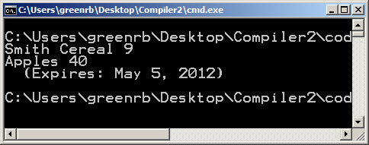
Inheritance – Example
int main() {
GenericItem miscItem;
ProduceItem perishItem;
miscItem.SetName("Smith Cereal");
miscItem.SetQuantity(9);
miscItem.PrintItem();
perishItem.SetName("Apples");
perishItem.SetQuantity(40);
perishItem.SetExpiration("May 5, 2012");
perishItem.PrintItem();
cout << " (Expires: " << perishItem.GetExpiration()
<< ")" << endl;
return 0;
}

Slide 11
Inheritance - Questions
A class that can serve as a basis for another class is called a ______ class.

Slide 12
Inheritance - Questions
A class that can serve as a basis for another class is called a ______ class.
BASE
Class Dwelling has a data member door1, door2, door3. A class House is derived from Dwelling and has data members wVal, xVal, yVal, zVal. The definition House h; creates how many data members?

Slide 13
Inheritance - Questions
A class that can serve as a basis for another class is called a ______ class.
BASE
Class Dwelling has a data member door1, door2, door3. A class House is derived from Dwelling and has data members wVal, xVal, yVal, zVal. The definition House h; creates how many data members?
7

Slide 14
Access by members of derived classes
Members of a derived class have access to the public members of the base class, but not private.
Third access specifier – protected
Provides access to derived classes BUT not to main or other functions not associated with the derived classes
class BaseClass{
private: // Members accessible only by self
protected: // Members accessible to Derived classes
public: // Members accessible to anyone
};

Slide 15
Access by members of derived classes
class DerivedClass : public BaseClass { … } - Public has a different purpose
public:
public → public protected → protected private
protected:
public → protected protected → protected private
private:
public → private protected → private private

Slide 16
Access by members of derived classes – True or False
BaseClass’ public member function can be called by a member function of DerivedClass

Slide 17
Access by members of derived classes – True or False
BaseClass’ public member function can be called by a member function of DerivedClass
TRUE

Slide 18
Access by members of derived classes – True or False
BaseClass’ public member function can be called by a member function of DerivedClass
TRUE
BaseClass’ protected member function can be called by a member function of DerivedClass.

Slide 19
Access by members of derived classes – True or False
BaseClass’ public member function can be called by a member function of DerivedClass
TRUE
BaseClass’ protected member function can be called by a member function of DerivedClass.
TRUE

Slide 20
Access by members of derived classes – True or False
BaseClass’ public member function can be called by a member function of DerivedClass
TRUE
BaseClass’ protected member function can be called by a member function of DerivedClass.
TRUE
BaseClass’ private data members can be accessed by a member function of DerivedClass

Slide 21
Access by members of derived classes – True or False
BaseClass’ public member function can be called by a member function of DerivedClass
TRUE
BaseClass’ protected member function can be called by a member function of DerivedClass.
TRUE
BaseClass’ private data members can be accessed by a member function of DerivedClass
FALSE

Slide 22
Access by members of derived classes – True or False
BaseClass’ public member function can be called by a member function of DerivedClass
TRUE
BaseClass’ protected member function can be called by a member function of DerivedClass.
TRUE
BaseClass’ private data members can be accessed by a member function of DerivedClass
FALSE
For DerivedClass derivedObj; in main(), derivedObj can access a protected member of BaseClass.

Slide 23
Access by members of derived classes – True or False
BaseClass’ public member function can be called by a member function of DerivedClass
TRUE
BaseClass’ protected member function can be called by a member function of DerivedClass.
TRUE
BaseClass’ private data members can be accessed by a member function of DerivedClass
FALSE
For DerivedClass derivedObj; in main(), derivedObj can access a protected member of BaseClass.
FALSE

Slide 24
Overriding member functions
Overriding != Overloading
Overloading → functions have the same name but different parameter types
Overriding → derived class member function takes precedent over a function with the same name, regardless of parameter types

Slide 25
Overriding member functions
class Base{
public:
void display(){
cout << “hello from Base Class” << endl;
};
};
class Derived : public Base{
public:
void display(){
cout << “hello from Derived Class” << endl;
};
};

Slide 26
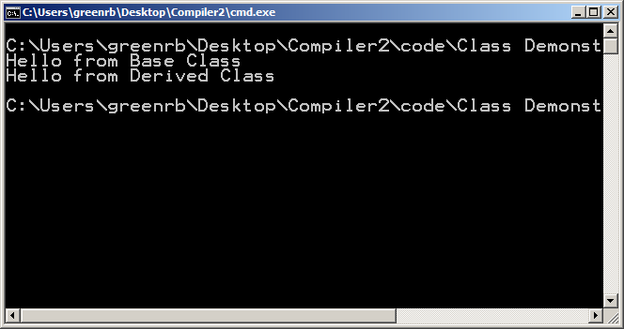
Overriding member functions
int main()
{
Base b1;
Derived d1;
b1.display();
d1.display();
}

Slide 27
Overriding member functions
Overriding function can still get access to overridden function by using :: operator
class Derived : public Base{
public:
void display(){
Base :: display();
cout << “hello from Derived Class” << endl;
};
};

Slide 28
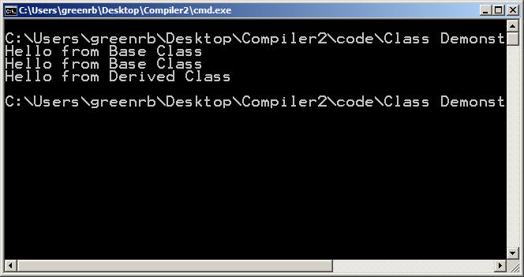
Overriding member functions
int main()
{
Base b1;
Derived d1;
b1.display();
d1.display();
}

Slide 29
Overloading member function - Questions
Assume myItem is defined as GenericItem, and myProduce as ProduceItem. Each have a function called PrintItem().
myItem.PrintItem() calls the PrintItem() function for which class?

Slide 30
Overloading member function - Questions
Assume myItem is defined as GenericItem, and myProduce as ProduceItem. Each have a function called PrintItem().
myItem.PrintItem() calls the PrintItem() function for which class?
GenericItem

Slide 31
Overloading member function - Questions
Assume myItem is defined as GenericItem, and myProduce as ProduceItem. Each have a function called PrintItem().
myProduce.PrintItem() calls the PrintItem() function for which class?

Slide 32
Overloading member function - Questions
Assume myItem is defined as GenericItem, and myProduce as ProduceItem. Each have a function called PrintItem().
myProduce.PrintItem() calls the PrintItem() function for which class?
ProduceItem

Slide 33
Overloading member function - Questions
Assume myItem is defined as GenericItem, and myProduce as ProduceItem. Each have a function called PrintItem().
Provide a statement within PrintItem() function of the ProduceItem class to call the PrintItem() function of ProduceItem's base class.

Slide 34
Overloading member function - Questions
Assume myItem is defined as GenericItem, and myProduce as ProduceItem. Each have a function called PrintItem().
Provide a statement within PrintItem() function of the ProduceItem class to call the PrintItem() function of ProduceItem's base class.
GenericItem::PrintItem();

Slide 35
Overloading member function - Questions
If ProduceItem did NOT have its own PrintItem() function defined, the PrintItem() function of which class would be called?

Slide 36
Overloading member function - Questions
If ProduceItem did NOT have its own PrintItem() function defined, the PrintItem() function of which class would be called?
GenericItem

Slide 37
Polymorphism and virtual member functions
Polymorphism – determination of which program behavior to execute depending on data types
Compile-time polymorphism – compiler determines what to call/run at compile time
(Function Overloading)
Runtime polymorphism – compiler cannot make determination, so determination is made at run time.
(Some instances of Function Overriding)

Slide 38
Polymorphism and virtual member functions
Base/Derived Class Example: Class Declarations
class Base{
public:
void display(){
cout << "Hello from Base Class" <<endl;
};
};
class Derived : public Base{
public:
void display(){
cout << "Hello from Derived Class" <<endl;
};
};

Slide 39
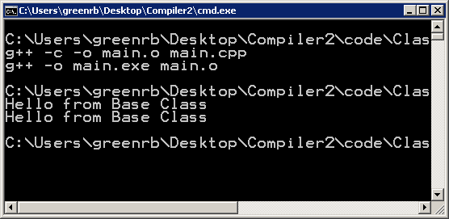
Polymorphism and virtual member functions
Base/Derived Class Example: Main
int main()
{ Base* bPtr = 0;
Derived* dPtr = 0;
vector<Base*> arr;
bPtr = new Base;
dPtr = new Derived;
arr.push_back(bPtr);
arr.push_back(dPtr);
arr.at(0)->display();
arr.at(1)->display();
}
Because the compiler doesn’t know if the content in the vector belongs to the Base or Derived class, so it defaults to display() from the base class.
Because the vector is of Base* type

Slide 40
Polymorphism and virtual member functions
Base/Derived Class Example: Class Declarations
class Base{
public:
virtual void display(){
cout << "Hello from Base Class" <<endl;
};
};
class Derived : public Base{
public:
void display(){
cout << "Hello from Derived Class" <<endl;
};
};
Solution: append virtual to the function declaration.

Slide 41
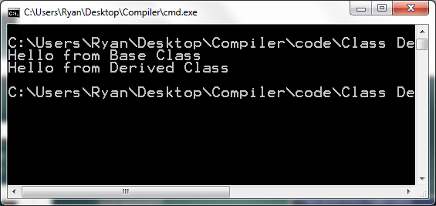
Polymorphism and virtual member functions
Base/Derived Class Example: Main
int main()
{ Base* bPtr = 0;
Derived* dPtr = 0;
vector<Base*> arr;
bPtr = new Base;
dPtr = new Derived;
arr.push_back(bPtr);
arr.push_back(dPtr);
arr.at(0)->display();
arr.at(1)->display();
}

Slide 42
Polymorphism and virtual member functions
Purely virtual function – function must be defined in a derived class
virtual void display() = 0;
Abstract base class – a class that has at least one pure virtual function. Objects cannot be defined of that type.

Slide 43
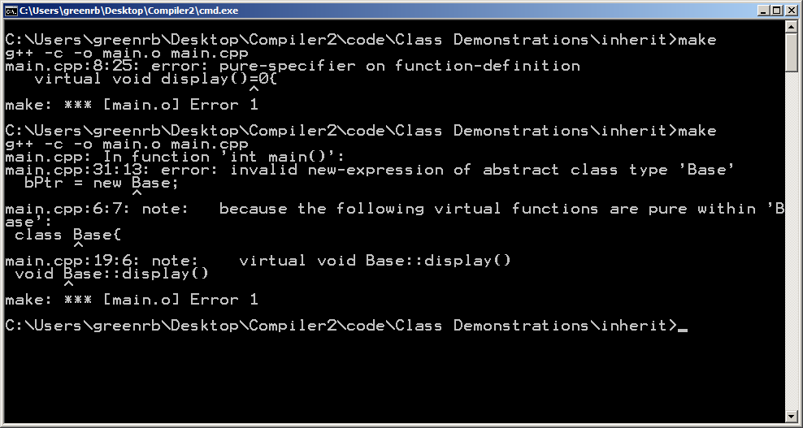
Polymorphism and virtual member functions
Updated Example:

Slide 44
Polymorphism and virtual member functions
Consider GenericItem and ProduceItem classes where ProduceItem is derived from GenericItem
TRUE OR FALSE
An item of type ProduceItem* may be added to a vector of type vector<GenericItem*>

Slide 45
Polymorphism and virtual member functions
Consider GenericItem and ProduceItem classes where ProduceItem is derived from GenericItem
TRUE OR FALSE
An item of type ProduceItem* may be added to a vector of type vector<GenericItem*>
TRUE

Slide 46
Polymorphism and virtual member functions
Consider GenericItem and ProduceItem classes where ProduceItem is derived from GenericItem
TRUE OR FALSE
Prepending the word virtual to GenericItem’s PrintItem() function allows a derived class like ProduceItem to override with its own PrintItem() function.

Slide 47
Polymorphism and virtual member functions
Consider GenericItem and ProduceItem classes where ProduceItem is derived from GenericItem
TRUE OR FALSE
Prepending the word virtual to GenericItem’s PrintItem() function allows a derived class like ProduceItem to override with its own PrintItem() function.
FALSE
Derived classes can override any base class member function. Virtual is used for run-time polymorphism

Slide 48
Polymorphism and virtual member functions
Consider GenericItem and ProduceItem classes where ProduceItem is derived from GenericItem
TRUE OR FALSE
A class having a pure virtual function implies that objects of that class type cannot be defined.

Slide 49
Polymorphism and virtual member functions
Consider GenericItem and ProduceItem classes where ProduceItem is derived from GenericItem
TRUE OR FALSE
A class having a pure virtual function implies that objects of that class type cannot be defined.
TRUE

Slide 50
Is-a versus has-a relationships
Inheritance is commonly confused with Composition
Composition – an object is made up of other object or (Has-a) relationships
Houses have Doors
Automobiles have Engines
People have Opinions
Inheritance – an object that is a subset of another object
Mansion is a house
School Bus is an automobile
Professors are People

